Slide 1
Advanced Depth Sensing Algorithms for Autonomous Vehicles
Farhan Hai Khan
Srijani Das
Soumyadip Sarkar
Deepjyoti Misra
Anand Saha
Mentor :
Prof. Sanjoy Mondal

Slide 2
Problem Statement: General
To perform accurate and efficient depth sensing for better autonomous driving.
Object Tracking : Object Detection and Instance Segmentation - Region and Object of Interest identification
In this case the problem statement is to detect objects and sensing the depth from a captured or given image. The objects are mainly cars, trees, human beings, bench, road, cycle and many more which can become an obstacle for an self driving electric vehicle.
Our github: https://github.com/khanfarhan10/Autonomous-Vehicle-FYP

Slide 3
Problem Statement : Specific Pointers
Getting Vision Based Environmental Information for Autonomous Vehicle,
Monocular Depth Estimation - Using Triangulation and Deep Learning [Done]
Pedestrian Detection [Done]
Vehicle Detection [Done]
Road Segmentation [Done]
Lane Detection [Done]
Traffic Sign Detection [Not Done]
Behavioral Cloning [Previously Done]
Path Planning and ADAS [Not Done]
Animal detection on street for day/night time [Not Done]
Our github: https://github.com/khanfarhan10/Autonomous-Vehicle-FYP

Slide 4
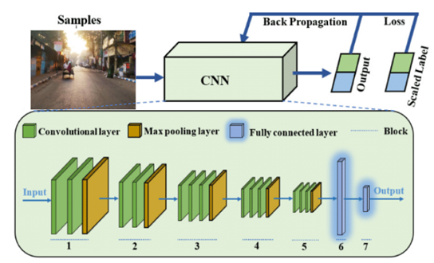
Convolutional Neural Network
Convolution Neural Network works similar to human brain recognition neural function. For humans there are three main layers, i.e. 1. local connection , 2. Layering , 3. Spatial invariance.
For CNN there are mainly four layers, i.e., convolution, max-pooling, normalization and backpropagation.
Block Diagram of CNN

Slide 5
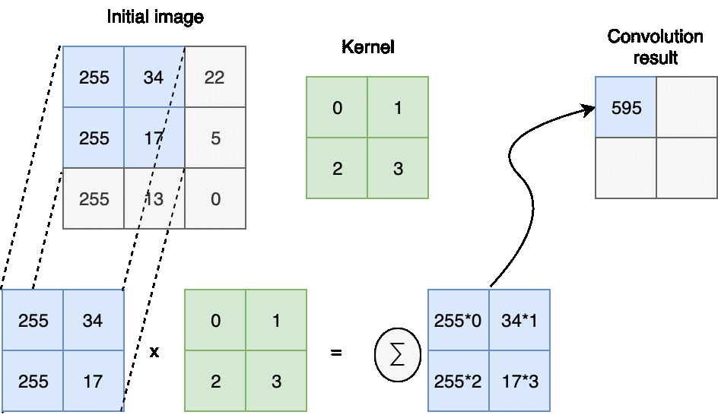
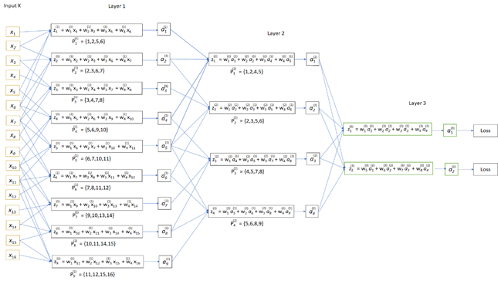
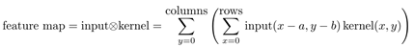
Convolutional Neural Network
Convolution
A dot product of a feature matrix or kernel is applied at a layer and on every part of that image iteratively.
Convolution by layer

Slide 6
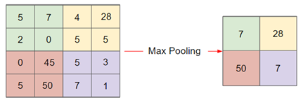
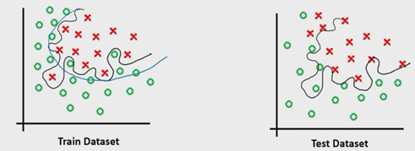
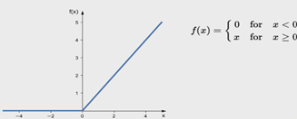
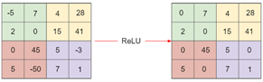
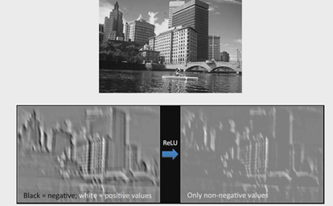
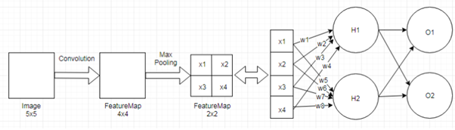
Convolutional Neural Network
ReLU Activation Function
Drop out
Backpropagation and error actuation
when we train our model with very accuracy but a very low test accuracy it becomes a problem of overfitting and to avoid it we drop out neurons at a time after each set of convolution and ReLU.
Hn(in)=w1x1+...+wnxn+b1
Hn(out)=1/(1+e^(-h(in))
On(in)=w1x1+...+wnxn+b2
On(out)=1/(1+e^(-O(in))
ReLU Applied on image
Source:https://pydeeplearning.weebly.com/blog/basics-of-convolutional-neural-networks

Slide 7
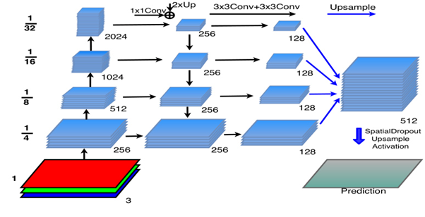
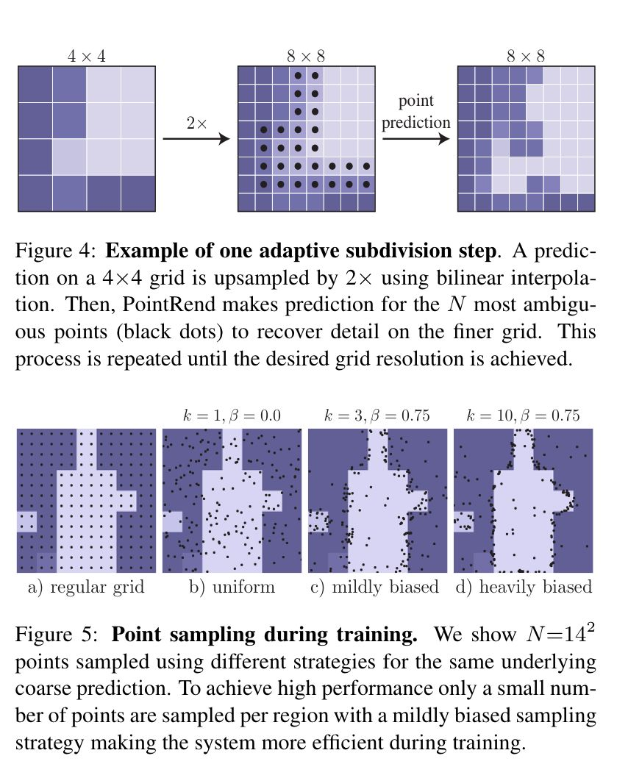
Image Segmentation & Object Detection based Hybridized Approach
Here CNN architectures like PointRend is used for performing state-of-the-art Instance Segmentation of Images which can be translated into Road,Car and traffic detection. From these high-scoring pre-trained methodologies, we have come up with design algorithms for combining the same for predicting depth sensing.
Source: https://ieeexplore.ieee.org/document/9156402
DATASET USED: Common Objects in Context (COCO)

Slide 8
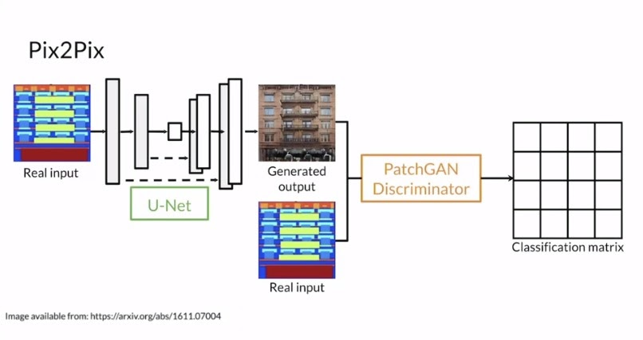
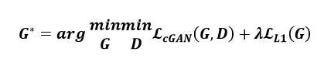
Pix2Pix
Advanced Pix-2-Pix Conditional GAN Deep Learning Model - Pix2Pix is a Generative Adversarial Network, or GAN, model designed for general purpose image-to-image translation. These Neural Networks mostly display great performance and convincing results in the science and art of autonomous driving. Rather than simple depth-sensing, the unique generator-discriminator approach using GANs for the task is actually what enables these models to predict high evaluation metric output disparity predictions.
After training Pix2Pix on the training dataset, as shown below and tested on the validation and test datasets, the generator of Pix2Pix trying to improve the results and makes predictions which look like ground truths from the perspective of contours and edges.

Slide 9
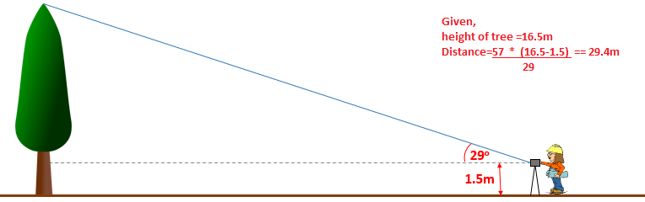
The Rule of 57
An object with angular size of 1 deg is about 57 times far away than it is big.
Distance of the object= 57 * Actual Size of the Object
Angular size in degrees

Slide 10
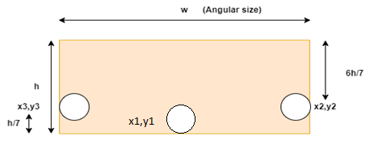
Anchor box
They consists of the coordinates of the object/ obstruction.
The coordinates are finalized by normalization and vigorous training algorithms.

Slide 11
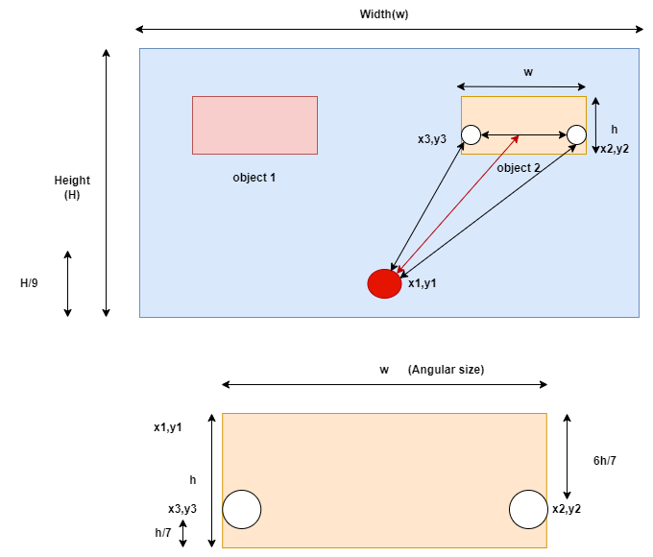
Triangulation Estimation : Monocular Depth Sensing
Estimation of Actual Depth on the Basis of Angle of View Estimation.
An approximation method for obtaining the Object Distance & Depth from the Point of View.
Can be applied with any object detection model.

Slide 12
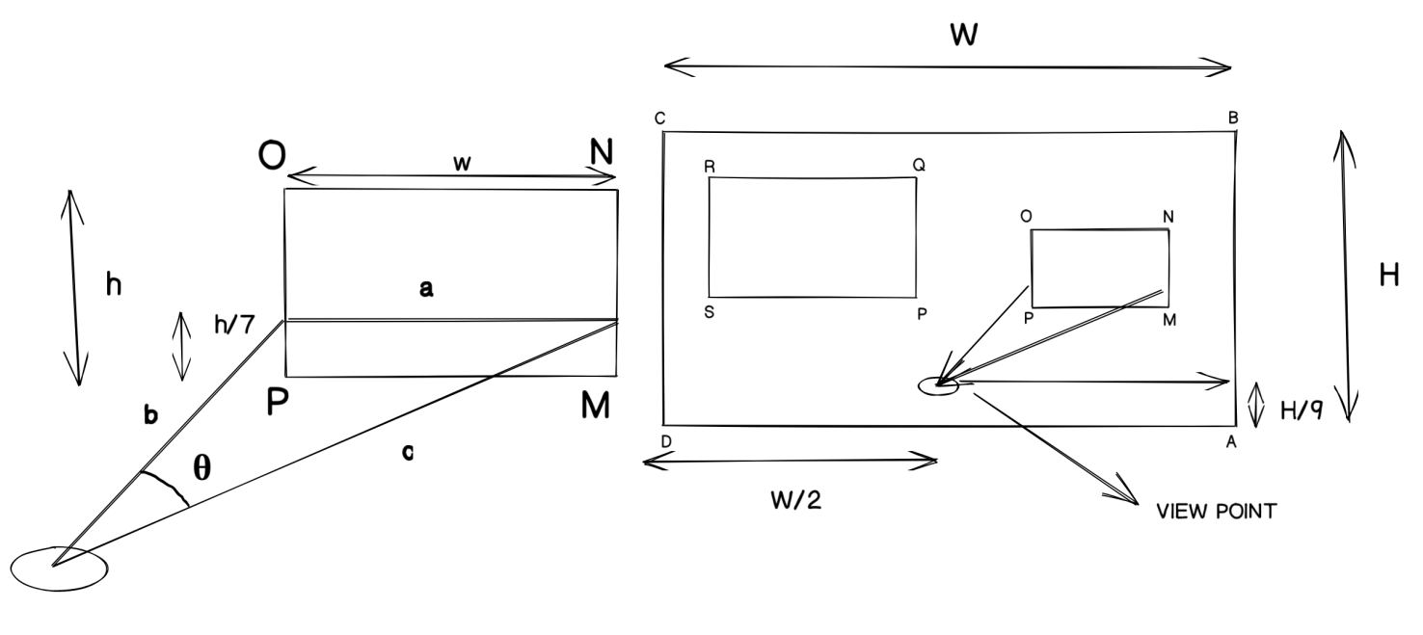
Triangulation Estimation : Mathematical Modelling

Slide 13
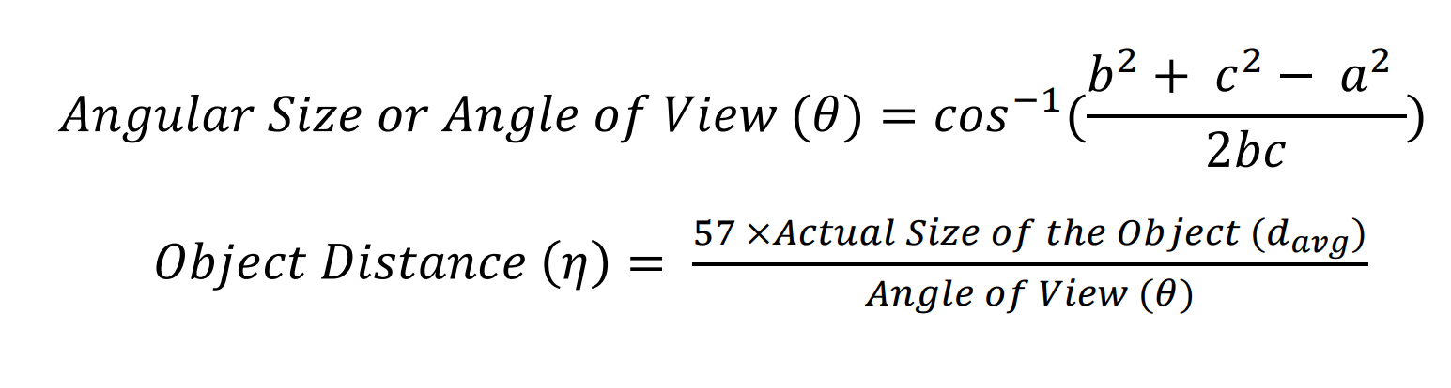
Triangulation Estimation : Relevant Equations

Slide 14
PointRend Instance Segmentation
Point-based Rendering neural network module: a module that performs point-based segmentation.
Some advanced designs that can be used in image segmentation are yolov, u-net &u-net++

Slide 15
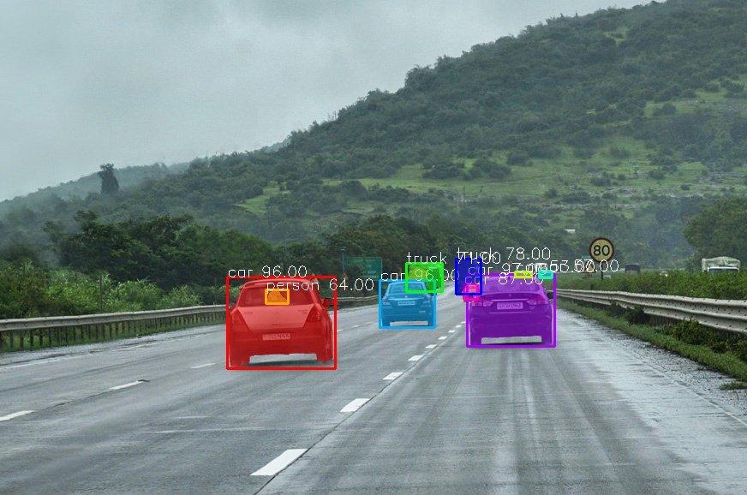
PointRend Outputs

Slide 16
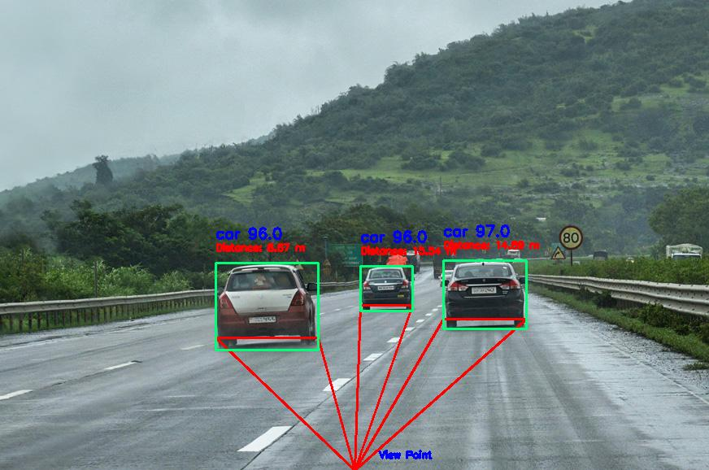
Triangulation Estimation : Simulation Results

Slide 17
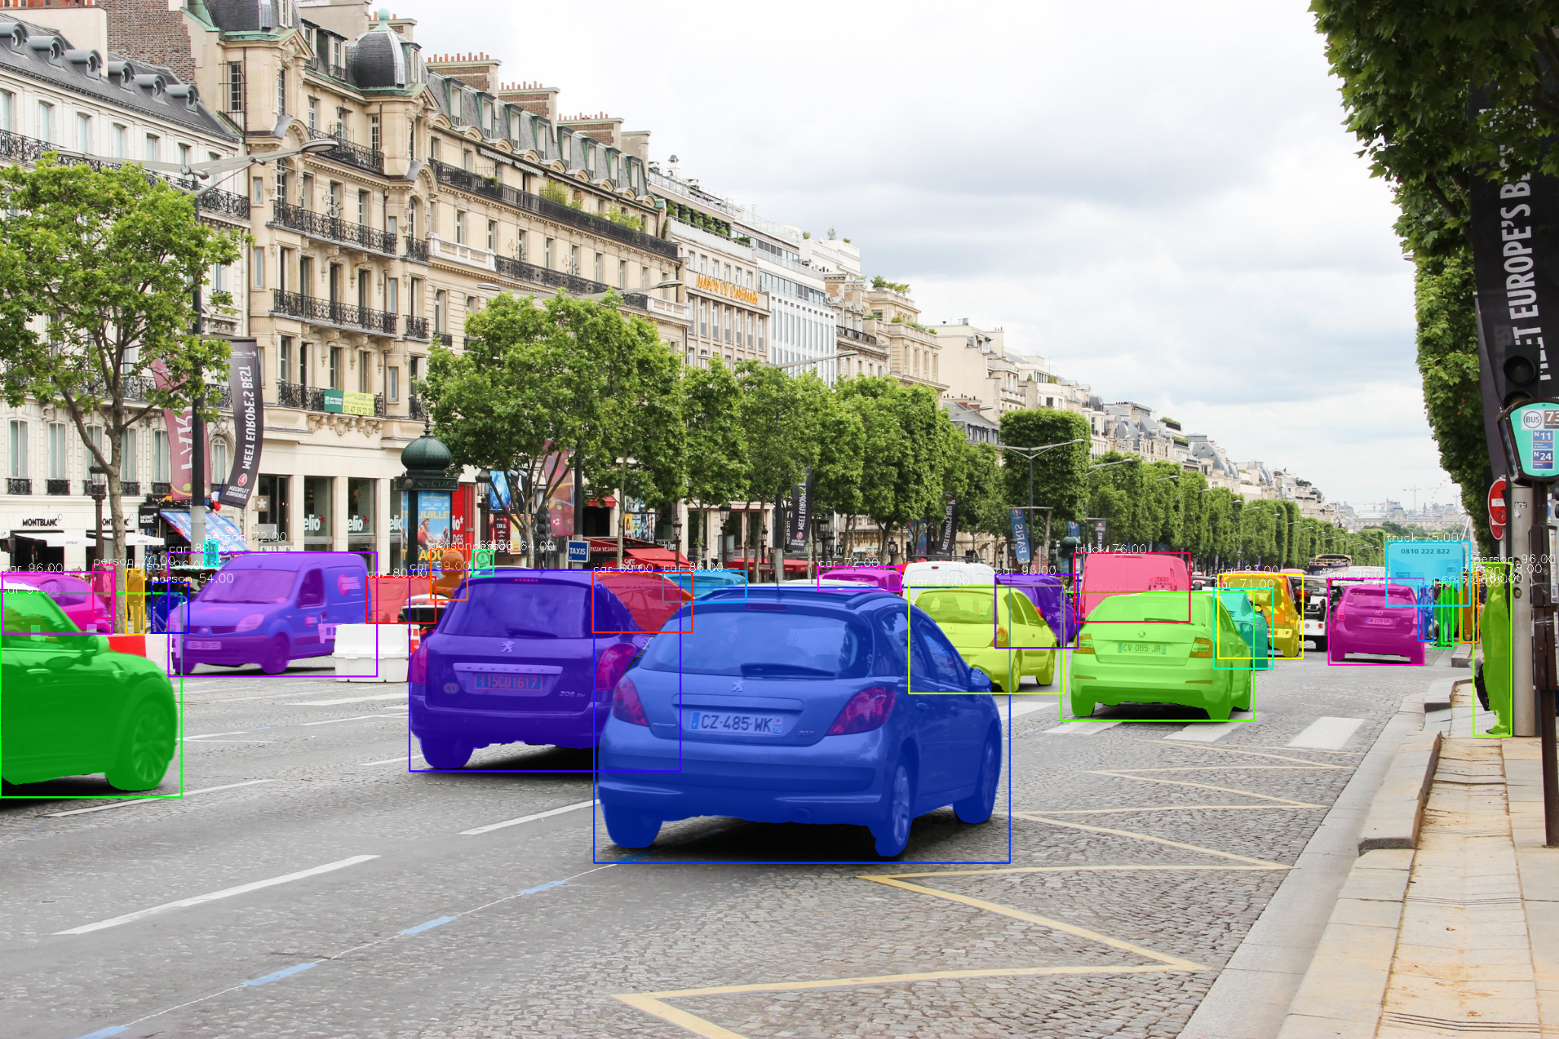
PointRend Outputs

Slide 18
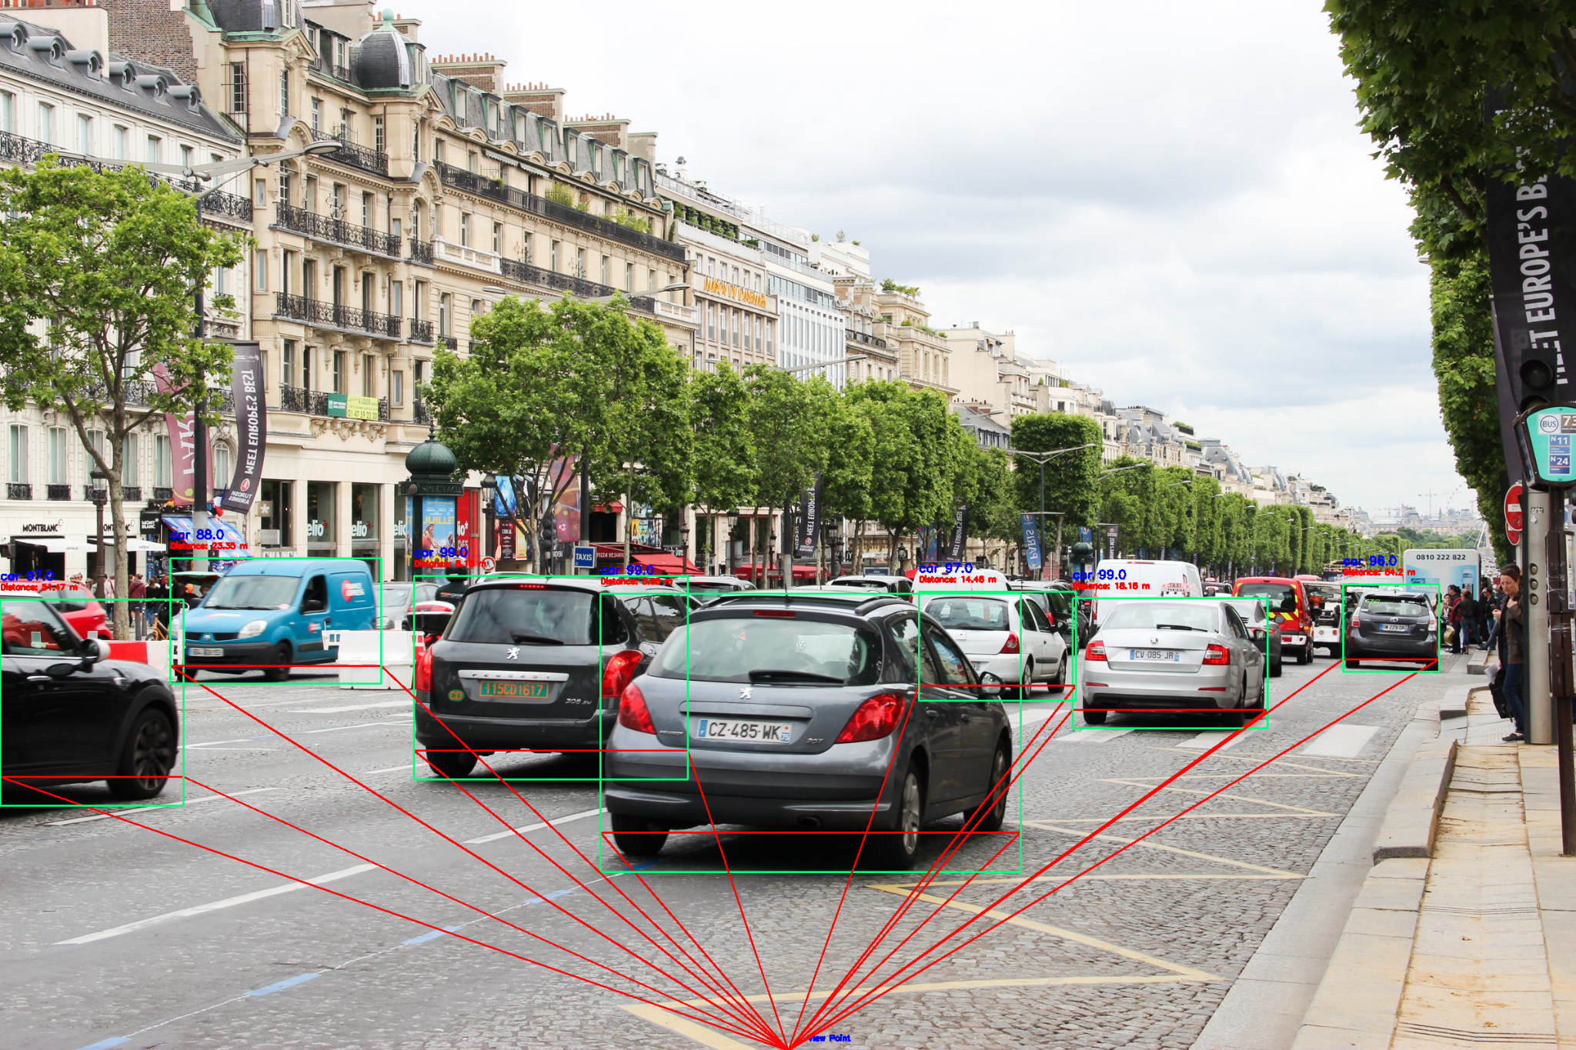
Triangulation Estimation : Simulation Results

Slide 19
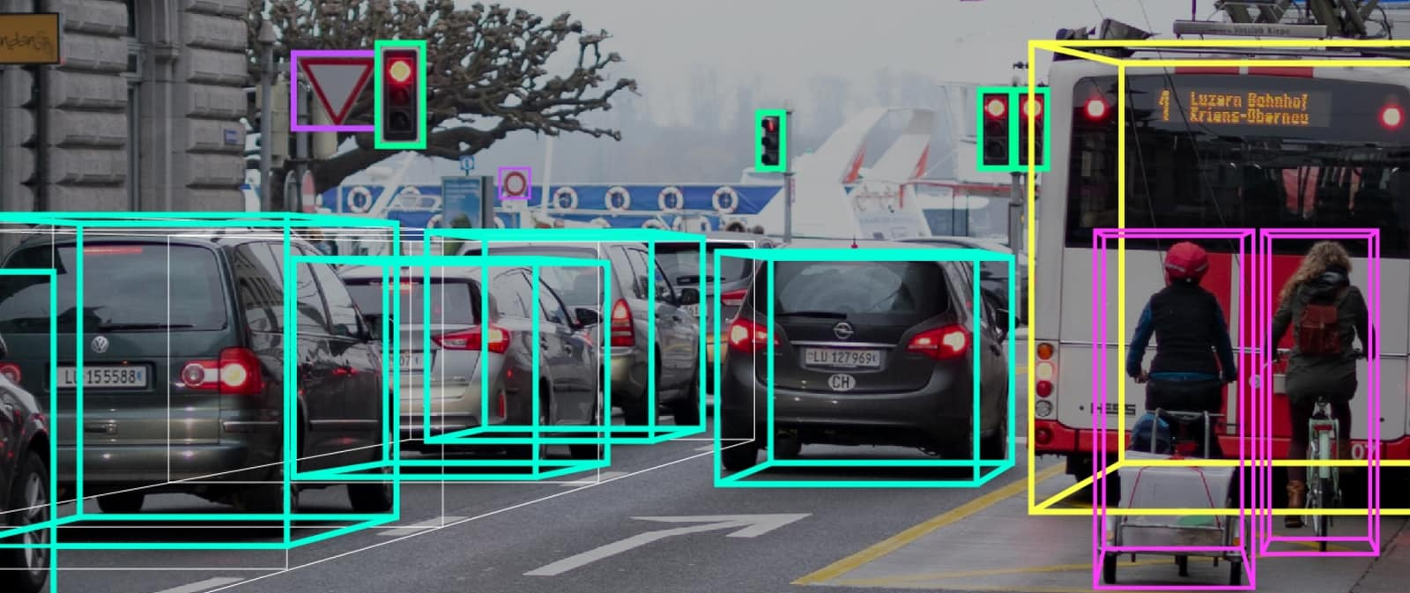
Image segmentation
Image segmentation is the process of partitioning a digital image into multiple image segments known as image regions
Some advanced designs that can be used in image segmentation are yolov, u-net &u-net++

Slide 20
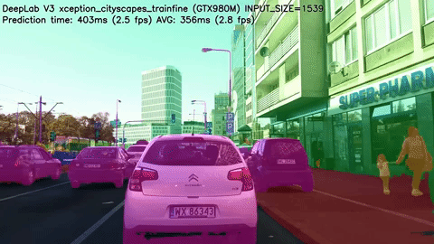
Semantic segmentation
Source: https://www.youtube.com/watch?v=ATlcEDSPWXY

Slide 21
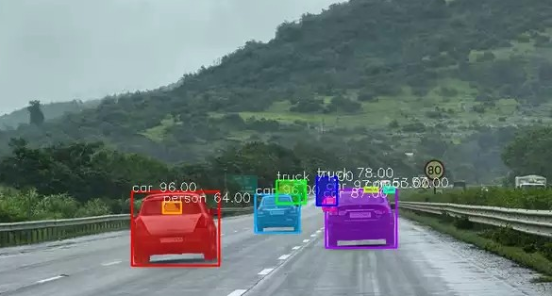
Pointrend design
A PointRend module accepts one or more typical CNN feature maps f(xi,yi) that are defined over regular grids, and outputs high-resolution predictions p(xi′,yi′) over finer grid.
These samples are then
refined using lightweight
Multilayer perceptrons i.e.
Neural networks.

Slide 22

U-net design
The U-net was developed by Olaf Ronneberger et al. for Bio Medical Image Segmentation. The architecture contains two paths. First path is the contraction path (also called as the encoder) which is used to capture the context in the image. The encoder is just a traditional stack of convolutional and max pooling layers. The second path is the symmetric expanding path (also called as the decoder) which is used to enable precise localization using transposed convolutions. Thus it is an end-to-end fully convolutional network (FCN), i.e. it only contains Convolutional layers and does not contain any Dense layer because of which it can accept image of any size.

Slide 23
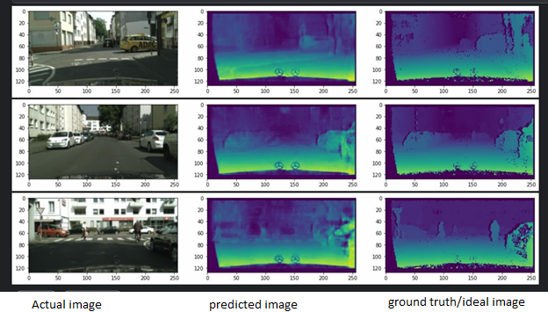

Slide 24
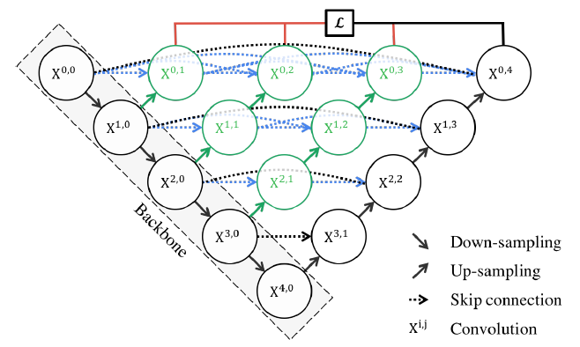
U-net ++
A much advanced version of u-net having deep supervision and minimal loss layer.

Slide 25
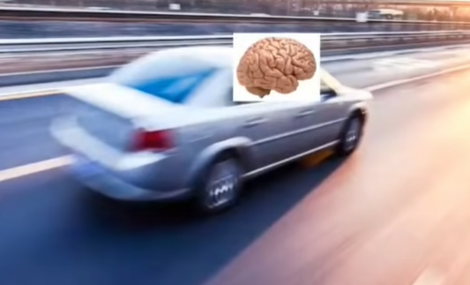
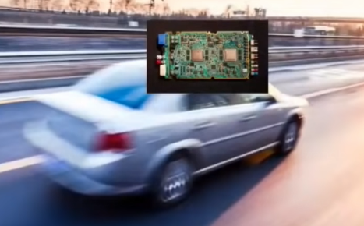
Need of Autonomous Vehicle
1ton object @80mph 250ms reaction latency Turn head, see mirrors in the turnings Human problems A. ~3700 /day deaths due to accidents B. drunk and drive C. Checking Instagram/twitter | 1ton object @80mph 250ms reaction latency << 100ms Turn head, see mirrors in the turnings 360deg awareness Human problems A. ~3700 /day deaths due to accidents dramatically reduce B. drunk and drive C. Checking Instagram/twitter

Slide 26
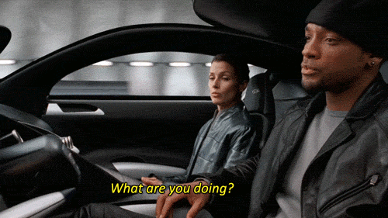
Reference: I, Robot

Slide 27
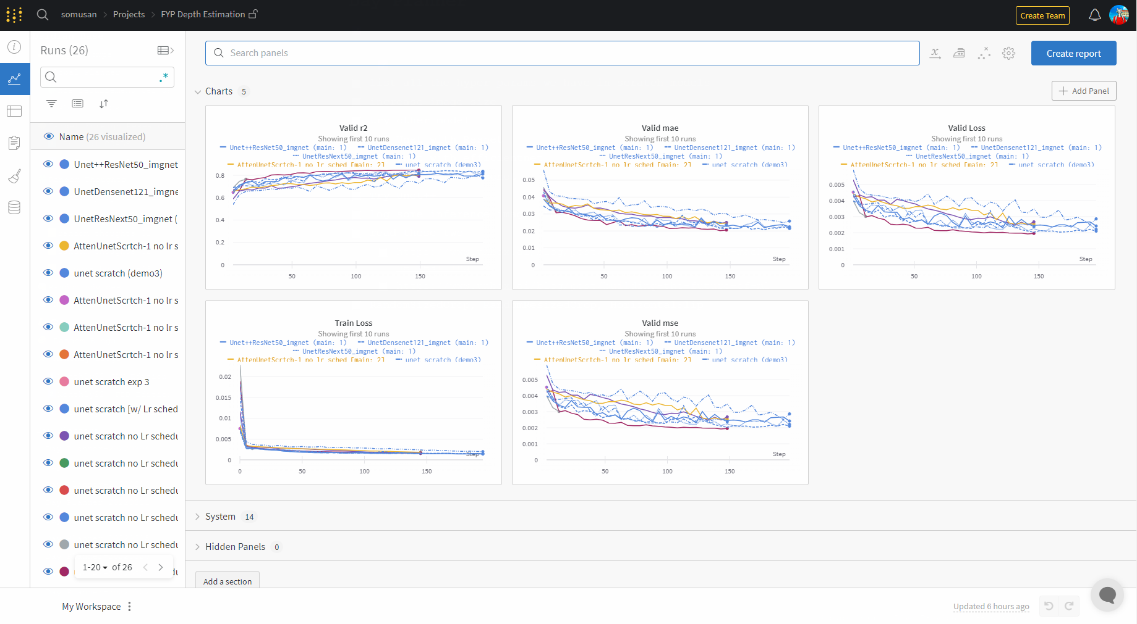
Experimentations w/ Unet for Depth Estimation:
WandB Link: https://bit.ly/Unet_fyp

Slide 28
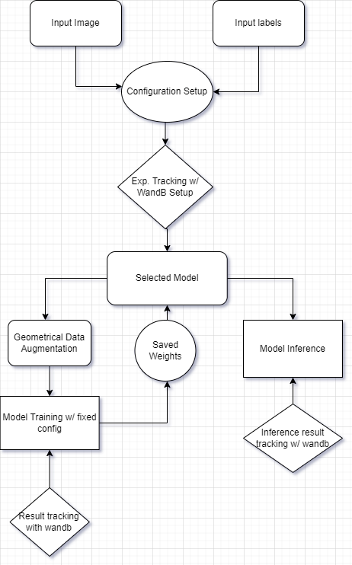
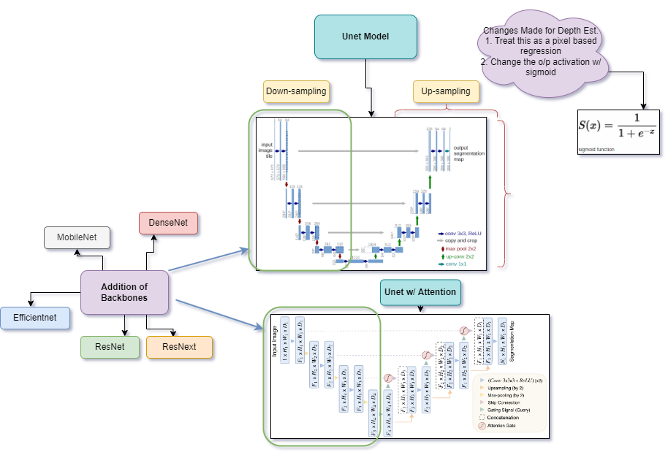
Project workflow
References:
Unet paper: https://arxiv.org/abs/1505.04597
Segmentation models: https://github.com/qubvel/segmentation_models.pytorch
Unet Attention: https://arxiv.org/abs/1804.03999

Slide 29
Quantitative Analysis:
Sl no | Config | mse | mae | r2 | inference | WandB
1 | Model: scratch Unet Log:MAE,MSE,R2,Adam,bs-16,e40 | 0.0024 | 0.024 | 0.807 | 46m 13s | Link
2 | Model: Scratch Unet2 Log:MAE,MSE,R2,Adam,bs16,e40,Lr-Sched | 0.0025 | 0.0248 | 0.8046 | 59m 1s | Link
3. | Model: AttenUnetScrtch Adam,bs16,e40,lr1-e4 | 0.0025 | 0.0243 | 0.8026 | 1h 0m 4s | Link
4. | Model: UnetResNet50_imgnet: Adam,bs-16,e40,Lr: 1e-3 | 0.0022 | 0.0221 | 0.8231 | 49m 33s | Link

Slide 30
Quantitative Analysis:
Sl no. | config | mse | mae | r2 | Time | wandb
5 | UnetResNext50_imgnet: Adam,bs-16,e40,Lr: 1e-3 | 0.0022 | 0.0221 | 0.8231 | 47m 14s | Link
6 | UnetDensenet121_imgnet: Adam,bs-16,e40,Lr: 1e-3 | 0.0022 | 0.0214 | 0.8317 | 48m 26s | Link
7 | Unet++Resnet50_imgnet: Adam,bs-16,e40,Lr: 1e-3 | 0.0023 | 0.0224 | 0.8202 | 1h 9m 50s | Link
8. | Unet++DensNet121 Adam,bs-16,e40,Lr: 1e-3 | 0.0022 | 0.0211 | 0.8328 | 1h 16m 20s | Link

Slide 31
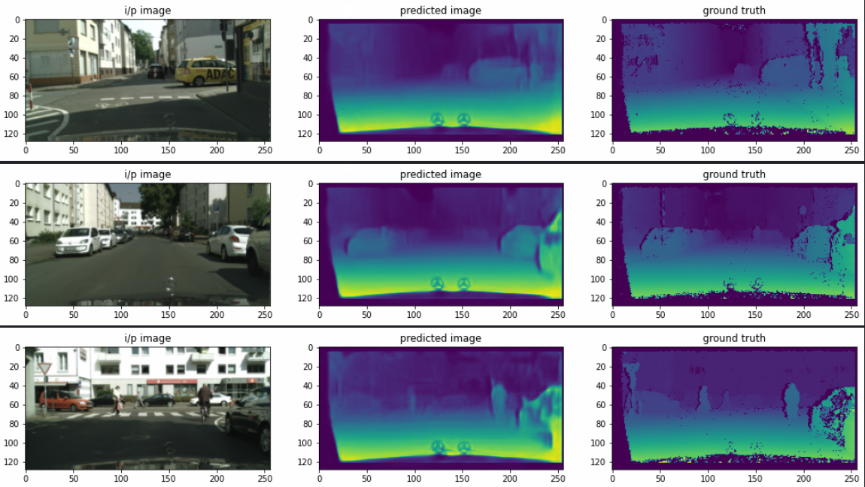
https://www.cityscapes-dataset.com/dataset-overview/

Slide 32





Tech Stack Used :

Slide 33
Conclusion :
We attempted to perform Depth Estimation using various Methodologies, for better Automated Vehicle Driving.
Future Scopes include

